Slide 1

CryptoForecast: LSTM Insights
Bitcoin Trading Data Analysis

Slide 2
Scope of the Project
What can machine learning do to improve Bitcoin exchange rate forecasts to create more effective trading strategies?
The project scope involved developing a robust machine learning tool incorporating advanced data analytics to forecast BTCUSD exchange rates, enhancing market predictions and facilitating effective trading strategies.

Slide 3
Project Description
Data Collection : From Yahoo Finance.
Data Preprocessing : Scaling the data, Spilt the Data
Model Development : Utilizing Sequential LSTM Model
Model Evaluation & Optimization
Visualization & Presentation
Documentation & Code Structuring
Project Delivery and Future Work

Slide 4
Research Questions to Answer
How does a machine learning tool enhance accurate market predictions, considering our innovative approach to forecasting Bitcoin prices using LSTM?
1
How does integrating statistical and trend analysis into our machine learning tool enhance its effectiveness in the dynamic cryptocurrency trading domain?
2
What considerations should be considered to trust a model, particularly regarding R-squared, MSE, and other metrics?
3

Slide 5
Dataset Selection
Source: Bitcoin historical data from Yahoo Finance.
Timeframe: January 1,2022 to November 15,2023.
Features : Open, High, Low, Close and Volume Prices of Bitcoin.

Slide 6
Training the Model
Efficient learning with Early Stopping and ReduceLROnPlateau
Preventing overfitting and fine-tuning for efficiency
Optimizing parameters with Timeseries Split and GridSearch CV

Slide 7
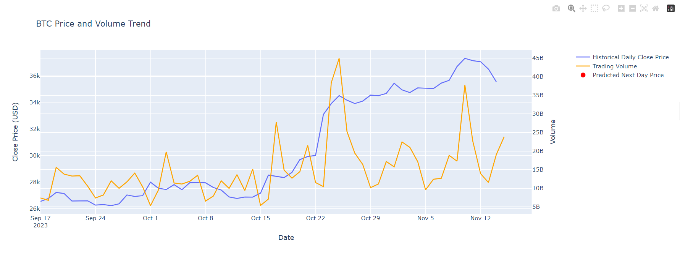
Analysis on BTC Price and Volume Trend

Slide 8
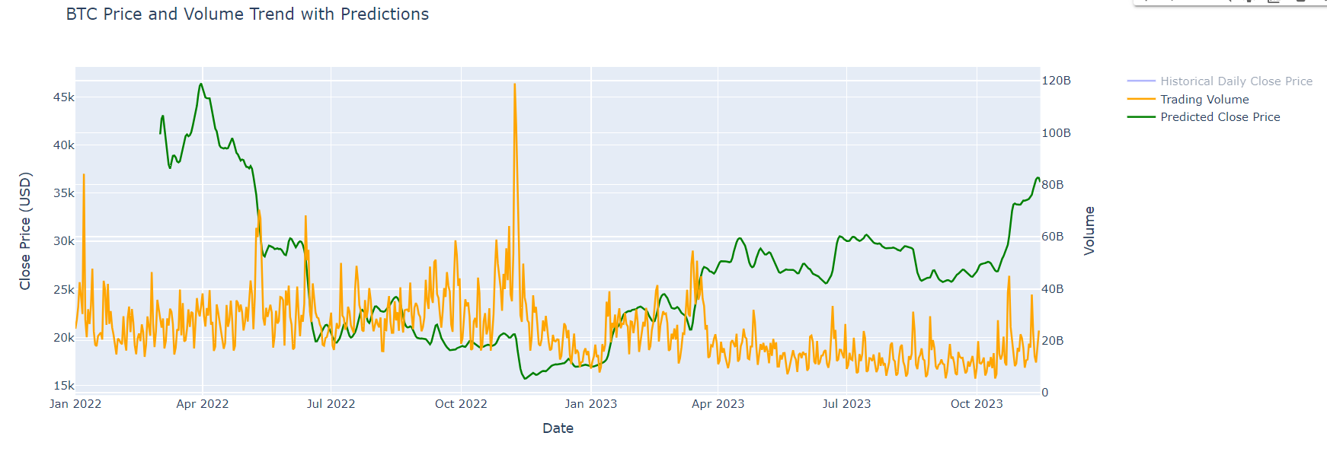
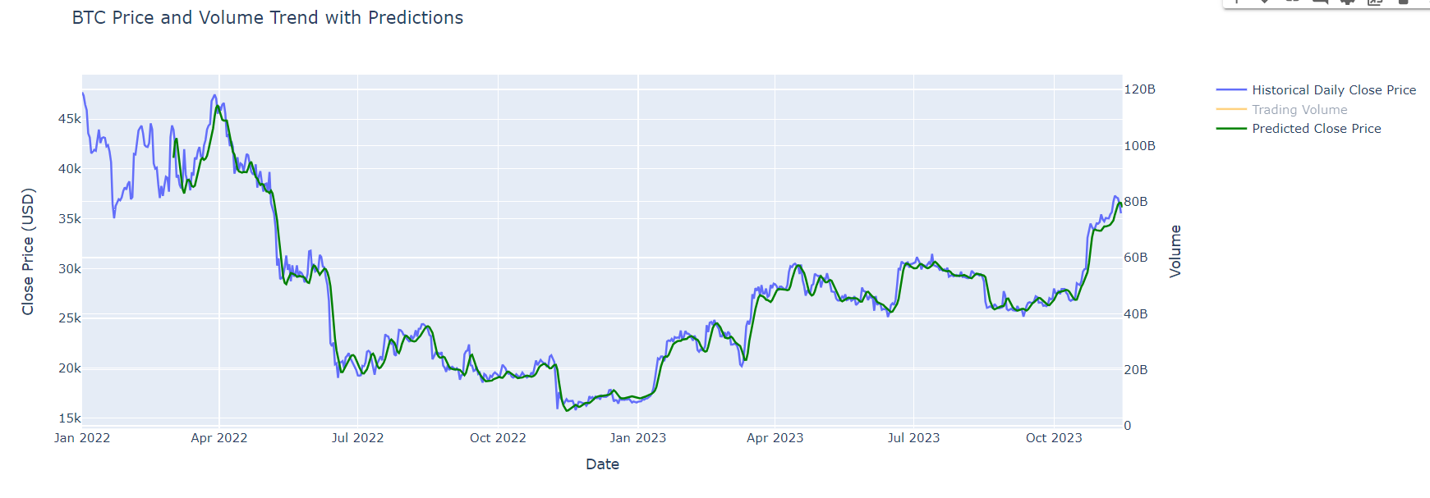
Analysis on BTC Price and Volume Trend with Predictions
Picture 1 shows Trading Volume with Predicted Close Price
Picture 2 shows Historical Daily Close price with Predicted Close Price

Slide 9
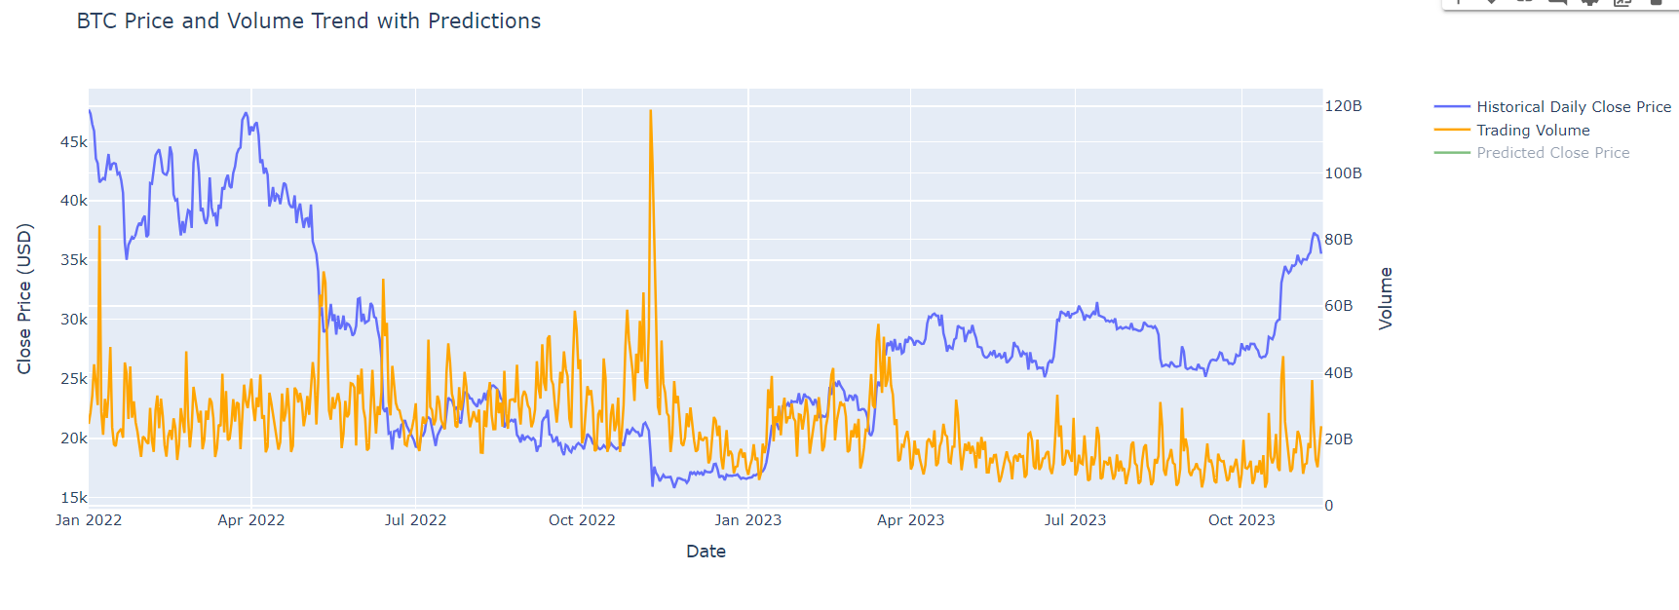
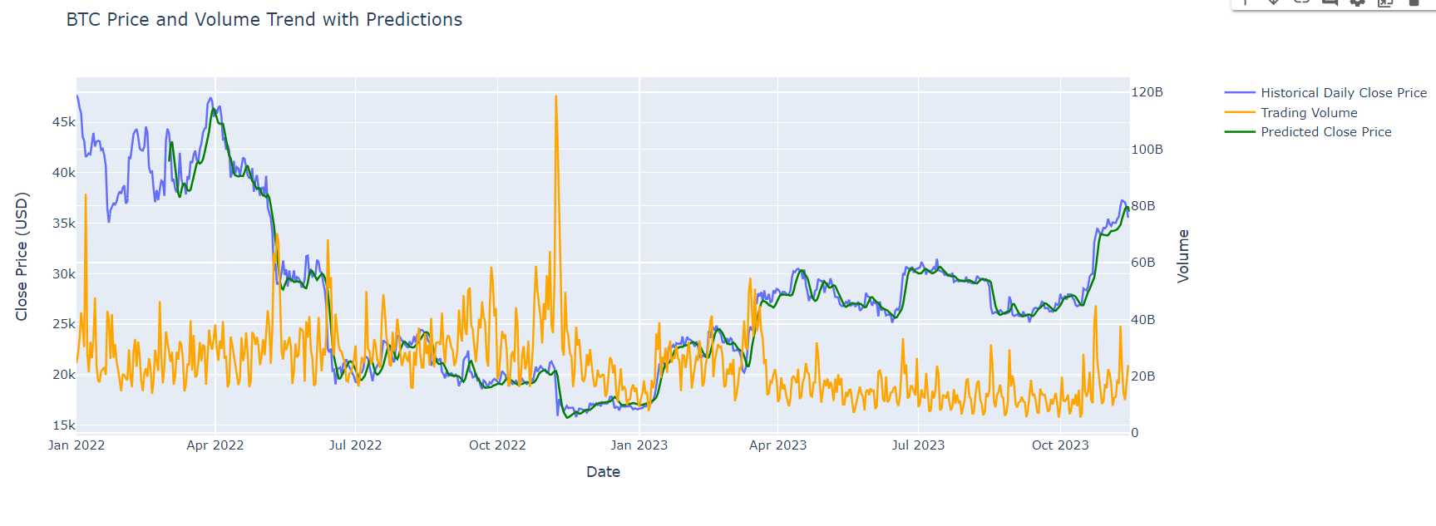
Analysis on BTC Price and Volume Trend with Predictions
Picture 1 shows Historical Daily Close Price with Trading Volume
Picture 2 shows BTC Price and Volume Trend with Predictions

Slide 10
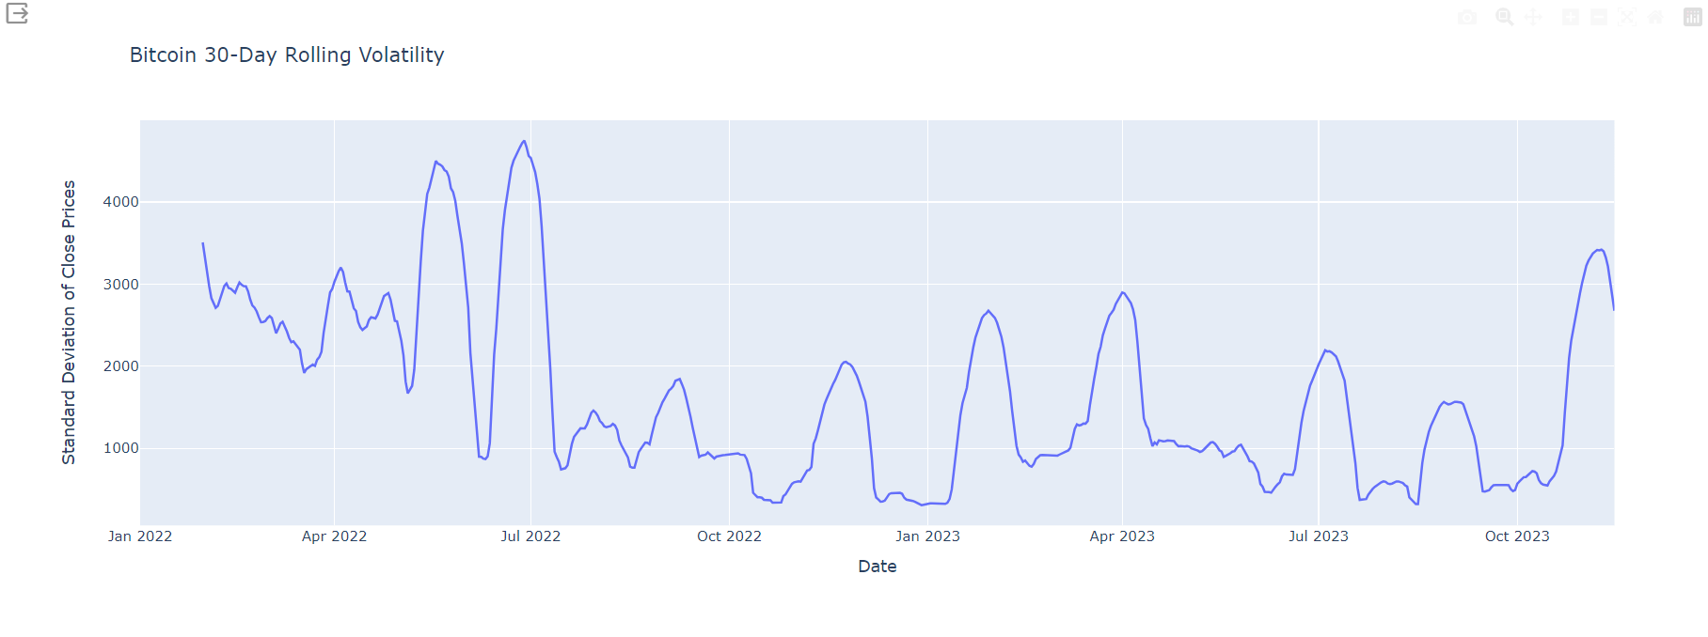
Analysis on Bitcoin 30-Day Rolling Volatility

Slide 11
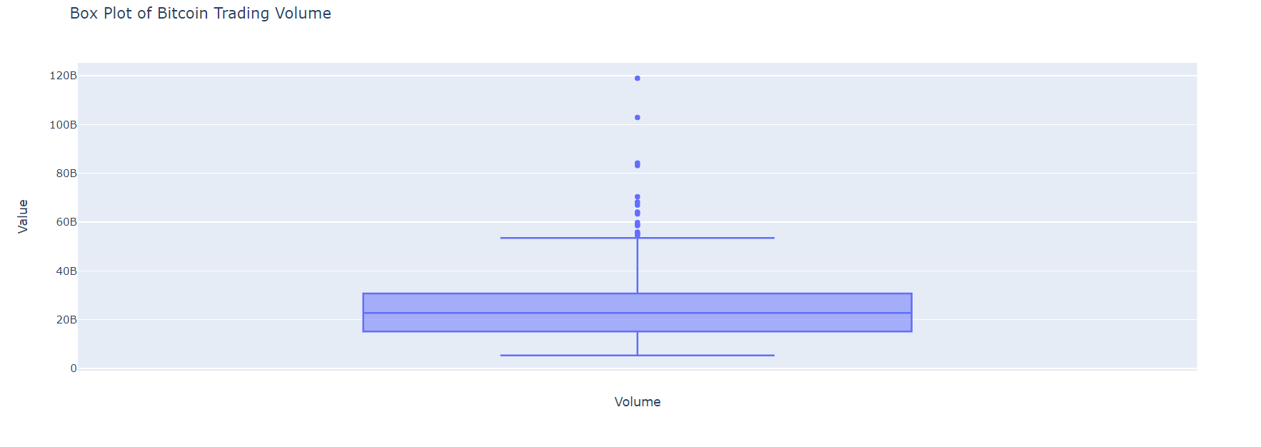
Analysis on Bitcoin Trading Volume

Slide 12
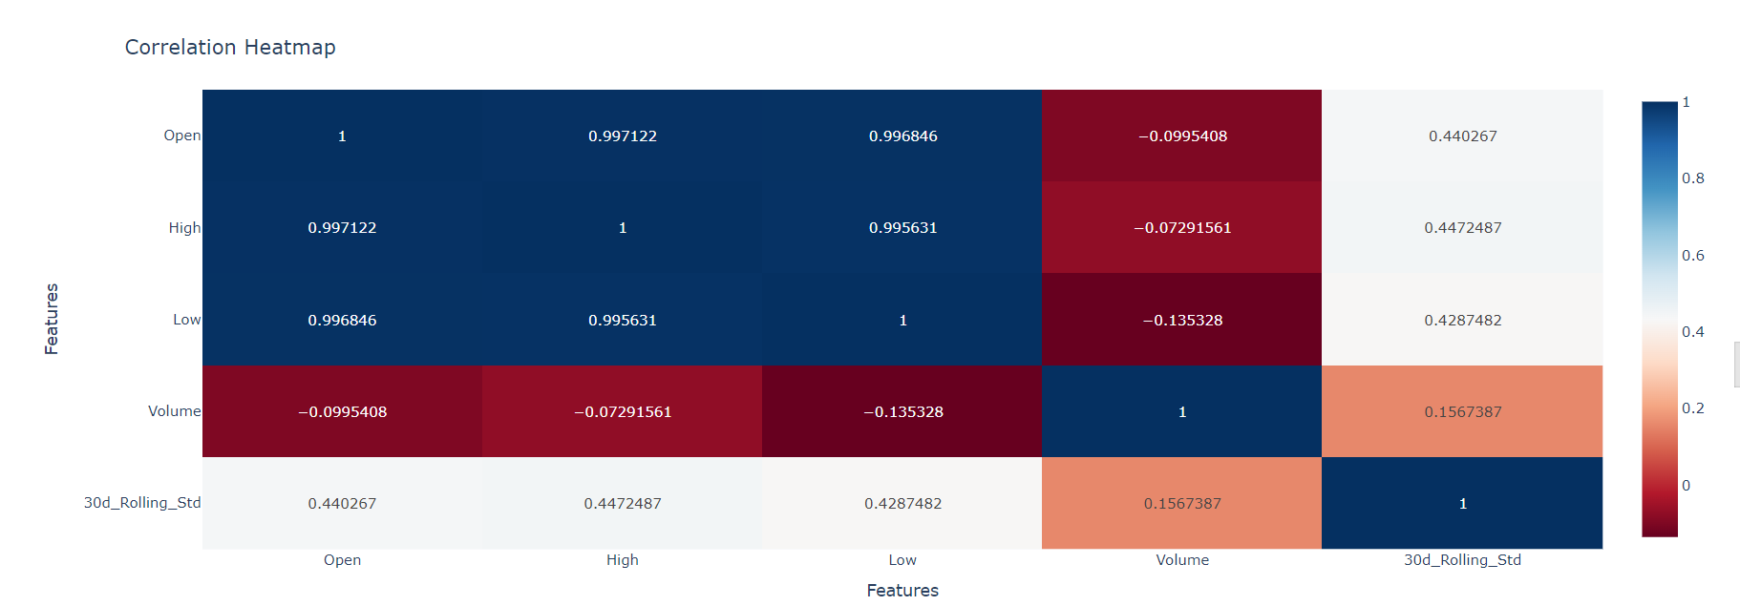
Analysis on Correlation Heatmap

Slide 13
Future developments, recommendations & summary
Explore diverse models (RandomForest, etc) for future market adaptability and more granular precision in prediction.
1
Evaluate the effectiveness of trading strategies using methods like the Simple Moving Average (SMA) to translate predictions into actionable insights
2
LTSM proved to be quite valuable in predicting BTCUSD trends.
3

